Slide 1
STATE TABLE AND DECISION TABLE BASED TESTING
Durga Prasad Mohapatra
Professor
Dept. of CSE
N.I.T. Rourkela

Slide 2
STATE TABLE – BASED TESTING
Tables are useful tools for representing and documenting many types of information relating to test case design.
These are beneficial for applications which can be described using state transition diagrams and state tables.

Slide 3
Basic terms related to State Table 1. Finite State Machine (FSM)
An FSM is a behavioral model whose outcome depends upon both the previous and current inputs.
This model can be prepared for software structure or software behavior.
It can be used as a tool for functional testing.

Slide 4
2. State Transition Diagrams or State Graph
A system or its components may have a number of states depending on its input and time.
States are represented by nodes.
With the help of nodes and transition links between nodes, a STD or SG can be prepared.

Slide 5
State Graph
A state graph is the pictorial representation of an FSM.
Its purpose is to depict the states that a system or its components can assume.
It shows the events or circumstances that cause or result from a change from one state to another.

Slide 6
State Graph cont …
Whatever is being modeled is subjected to inputs.
As a result of these inputs, when one state is changed to another is called a transition.
Transitions are represented by links that join the nodes.

Slide 7
Example
For example, a task in an O. S. can have its following states:
New State : When a task is newly created
Ready : When the task is waiting in the ready queue for its turn.
Running : When Instructions of the task are being executed by CPU.
Waiting : When the task is waiting for an I/O event or reception of a signal
Terminated : The task has finished execution.

Slide 8
State Graph
New State : When a task is newly created
Ready : When the task is waiting in the ready queue for its turn.
Running : When Instructions of the task are being executed by CPU.
Waiting : When the task is waiting for an I/O event or reception of a signal
Terminated : The task has finished execution.
New
Terminated
Admitted,T1
Exit,T6
Dispatch,T2
Ready
Running
Interrupt,T3
I/O or event wait, T4
I/O or event completion, T5
Waiting

Slide 9
New
Terminated
Admitted,T1
Exit,T6
Dispatch,T2
Ready
Running
Each arrow link provides two types of Information :
Transition events like admitted, dispatch, interrupt, etc.
The resulting output from a state like T1, T2, T3 etc.
T0=Task is in new state and waiting for admission to ready queue.
T1= A new task admitted to ready queue
T2= A ready task has started running
T3= Running task has been interrupted
T4= Running task is waiting for I/O or event
T5= Wait period of waiting task is over
T6= Task has completed execution
Interrupt,T3
I/O or event wait, T4
I/O or event completion, T5
Waiting

Slide 10
3. State Table
State/input Event | Admit | Dispatch | Interrupt | I/O or event Wait | I/O or event Wait Over | Exit
New | Ready/T1 | New / T0 | New / T0 | New / T0 | New / T0 | New / T0
Ready | Ready / T1 | Running /T2 | Ready / T1 | Ready / T1 | Ready / T1 | Ready / T1
Running | Running /T2 | Running /T2 | Ready / T3 | Waiting/T4 | Running/ T2 | Terminated/ T6
Waiting | Waiting/T4 | Waiting/T4 | Waiting/ T4 | Waiting/T4 | Ready /T5 | Waiting/T4
Each rows of the table corresponds to a state.
Each column corresponds to an input condition
The box at the intersection of a row and a column specifies the next state (transition) and the outputs, if any.

Slide 11
4. State Table-Based Testing
After reviewing the basics, we can start functional testing with state tables.
Steps:
1. Identify the states
The number of states in a state graph is the number of states we choose to recognize or model.

Slide 12
Finding the number of states
First, identify all the component factors of the state.
Identify all the allowable values for each factor
The number of states is the product of the number of allowable values of all the factors.

Slide 13
Steps cont …
2. Prepare state transition diagram after understanding transitions between states
After having all the states, identify the inputs on each state and transitions between states and prepare the state graph.
Every input state combination must have a specified transition.

Slide 14
Steps cont …
3. Convert the state graph into the state table as discussed earlier 4. Analyze the state table for its completeness.

Slide 15
Steps cont …
5. Develop the test cases from the state table, in a tabular form, with the following entries.
Test cases ID : a unique identifier for each test case
Test Source : a trace back to the corresponding cell in the state table.
Current state : the initial condition to run the test
Event : the input triggered by the user
Output : the current value returned
Next State : the new state achieved

Slide 16
Test Cases for the O.S. Example
Test case ID | Test Source | Input |  | Expected results
 |  | Current State | Event | Output | Next state
TC1 | Cell 1 | New | Admit | T1 | Ready
TC2 | Cell 2 | New | Dispatch | T0 | New
TC3 | Cell 3 | New | Interrupt | T0 | New
TC4 | Cell 4 | New | I/O wait | T0 | New
TC5 | Cell 5 | New | I/O wait over | T0 | New
TC6 | Cell 6 | New | Exit | T0 | New
TC7 | Cell 7 | Ready | Admit | T1 | Ready
TC8 | Cell 8 | Ready | Dispatch | T2 | Running
TC9 | Cell 9 | Ready | Interrupt | T1 | Ready
TC10 | Cell 10 | Ready | I/O wait | T1 | Ready
TC11 | Cell 11 | Ready | I/O wait over | T1 | Ready
TC12 | Cell 12 | Ready | Exit | T1 | Ready
TC13 | Cell 13 | Running | Admit | T2 | Running
TC14 | Cell 14 | Running | Dispatch | T2 | Running
TC15 | Cell 15 | Running | Interrupt | T3 | Ready
TC16 | Cell 16 | Running | I/O wait | T4 | Waiting
TC17 | Cell 17 | Running | I/O wait over | T2 | Running
TC18 | Cell 18 | Running | Exit | T6 | Terminated
TC19 | Cell 19 | Waiting | Admit | T4 | Waiting
TC20 | Cell 20 | Waiting | Dispatch | T4 | Waiting
TC21 | Cell 21 | Waiting | Interrupt | T4 | Waiting
TC22 | Cell 22 | Waiting | I/O wait | T4 | Waiting
TC23 | Cell 23 | Waiting | I/O wait over | T5 | Ready
TC24 | Cell 24 | Waiting | Exit | T4 | Waiting

Slide 17
Decision Table – Based Testing
Boundary value analysis and equivalence class partitioning methods do not consider combinations of input conditions.
There may be some critical behavior to be tested when some combinations of input conditions are considered.
Decision table is another useful method to represent the information in a tabular method.
Decision table has the specialty to consider complex combinations of input conditions and resulting actions.
Decision tables obtain their power from logical expressions.
Each operand or variable in a logical expression takes on the value, TRUE or FALSE

Slide 18
Formation of Decision Table
Condition Stub |  | Rule 1 | Rule 2 | Rule 3 | Rule 4 | ...
 | C1 C2 C3 | True False True | True True True | False False True | I True I
Action Stub | A1 A2 A3 | X | X | X | X
Condition stub It is a list a list of input conditions for which the complex combination is made.
Action stub It is a list of resulting action which will be performed if a combination of input condition is satisfied.

Slide 19
Condition entry
It is a specific entry in the table corresponding to input conditions mentioned in the condition stub.
When the condition entry takes only two values – TRUE or FALSE then it is called Limited Entry Decision Table.
When the condition entry takes several values , then it is called Extended Entry Decision Table.

Slide 20
Action entry It is the entry in the table for the resulting action to be performed.
List all actions that can be associated with a specific procedure.
List all conditions during execution of the procedure.
Associate specific sets of conditions with specific actions, eliminating impossible combinations and conditions; alternatively, develop every possible permutation of conditions.
Define rules by indicating what action occurs for a set of conditions.

Slide 21
Test Case Design using Decision Table
Interpret condition stubs as the inputs for the test case.
Interpret action stubs as the expected output for the test case.
Rule, which is the combination of input conditions, becomes the test case itself.
If there are k rules over n binary conditions, there are at least k test cases and at the most 2^{n} test cases.

Slide 22
Example - 1
A program calculates the total salary of an employee with the conditions that if the working hours are less than or equal to 48, then give normal salary. The hours over 48 normal working days are calculated at the rate of 1.25 of the salary. However, on holidays or Sundays, the hours are calculated at the rate of 2.00 times of the salary. Design test cases using decision table testing.
Solution
Entry
 |  | Rule 1 | Rule 2 | Rule 3
Condition Stub | C1: Working hours > 48 C2: Holidays or Sundays | I T | F F | T F
Action Stub | A1: Normal Salary A2: 1.25 of salary A3: 2.00 of salary | X | X | X

Slide 23
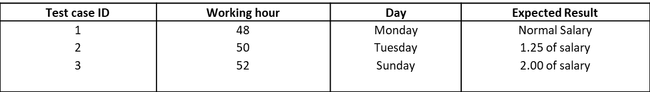
Decision Table

Slide 24
Expanding the Immaterial Cases in Decision Table
These conditions means that the value of a particular condition in the specific rule does not make a difference whether it is TRUE or FALSE.
Sometimes expanding the decision table to spell out don’t-care conditions can reveal hidden problems.

Slide 25
Example - 1
Entry (Decision table)
The immaterial test case in rule 1 of the above table can be expanded by taking both T and F values of C1.
 |  | Rule 1 | Rule 2 | Rule 3
Condition Stub | C1: Working hours > 48 C2: Holidays or Sundays | I T | F F | T F
Action Stub | A1: Normal Salary A2: 1.25 of salary A3: 2.00 of salary | X | X | X

Slide 26
Entry (Expanded decision table)
 |  | Rule 1-1 | Rule 1-2 | Rule 2 | Rule 3
Condition Stub | C1: Working hours > 48 C2: Holidays or Sundays | F T | T T | F F | T F
Action Stub | A1: Normal Salary A2: 1.25 of salary A3: 2.00 of salary | X | X | X | X
Entry (Expanded decision table)
Test case ID | Working hour | Day | Expected Result
1 2 3 4 | 48 50 52 30 | Monday Tuesday Sunday Sunday | Normal Salary 1.25 of salary 2.00 of salary 2.00 of salary

Slide 27
Example - 2
A wholesaler has three commodities to sell and has three types of customers. Discount is given as per the following procedure:
(a) For DGS & D orders, 10% discount is given irrespective of the value of the order.
(b) For orders of more than Rs 50,000, agents get a discount of 15% and the retailer gets a discount of 10%.
(c) For orders of Rs 20,000 or more and up to Rs 50,000, agents get 12% and the retailer gets 8% discount.
(d) For orders of less than Rs 20,000, agents get 8% and the retailer gets 5% discount.
The aforementioned rules do not apply to the furniture items wherein a flat rate of 10% discount s admissible to all customers irrespective of the value of the order.
Design the test cases for this system using decision table testing.

Slide 28
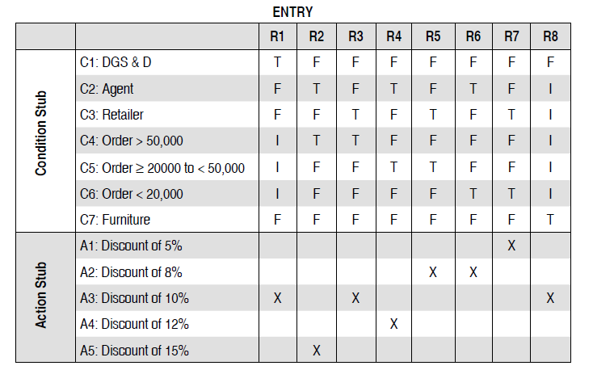
Decision Table for Example 2

Slide 29
Test cases for Example - 2
Test Case Id | Type of Customer | Product Furniture? | Order value (Rs) | Expected Result
1 | DGS & D | No | 51,000 | 10% Discount
2 | Agent | No | 52,000 | 15% Discount
3 | Retailer | No | 53,000 | 10% Discount
4 | Agent | No | 23,000 | 12% Discount
5 | Retailer | No | 27,000 | 8% Discount
6 | Agent | No | 15,000 | 8% Discount
7 | Retailer | No | 18,000 | 5% Discount
8 | Agent | Yes | 34,000 | 10% Discount

Slide 30
References
Naresh Chauhan, Software Testing: Principles and Practices, (Chapter – 4), Second Edition, Oxford University Press, 2016.

Slide 31
Thank You

